Slide 1
End of internship presentation
02/19/2020
Wali Ullah

Slide 2
Agenda
Safety
Introduction
Productivity Solutions
Achievements
What I learned
Future Plans
Questions?

Slide 3

Safety
Covid-19 Vaccination
Get it as soon as it’s available to you.
First shot vs. Second shot
Be aware of the side effects, but don’t be scared.
Seek immediate help incase of severe side effects
Don’t ignore the “immunity card” procedure.
It’s not over…yet.

Slide 4
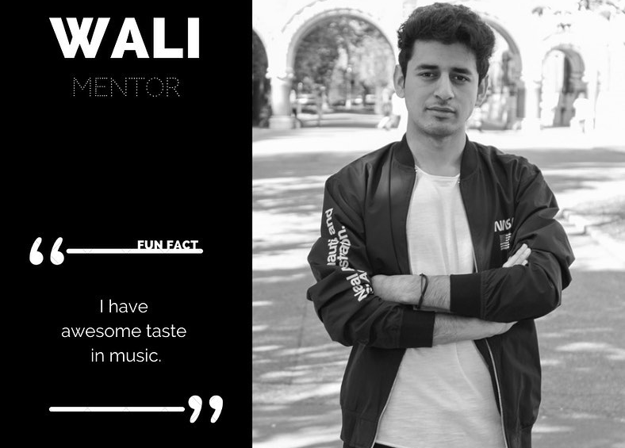


Wali
BME
Computer Science Engineering
Student Mentor with HÖOK
Hobbies:
Photography
Music
Gaming/Tech
Hiking

Slide 5
Productivity Solutions
What we do:
We build solutions that eliminate time spent on paper-based, repetitive, or manual registration processes by digitized forms and automated workflows.
We collect customer/commercial information required to enable first transaction.
We optimize user journey and minimize required input.
Who do we support:
ExxonMobil business customers
My role:
Identify opportunities and develop solutions.

Slide 6
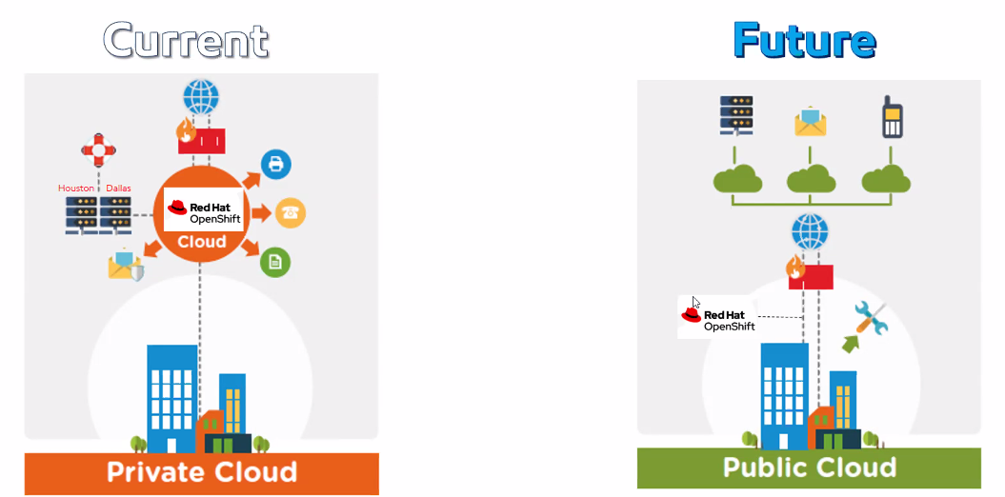
Achievements
Migration to Azure Cloud Services (Nodejs Seed)
Business challenge:
Services to be transferred from OpenShift containers Azure Cloud environment for more robust infrastructure before we extend our products to new markets.
Savings:
Hours – / year

Slide 7
What I learned
Developed a safety mindset.
Learned how to work as part of an Agile team.
Learned the history and basics of HTML, CSS, and JS
Gained a better understanding of the Web and Web applications
Worked with Git, ADO, and Azure
Had the opportunity to be part of something bigger.

Slide 8
Future Plans
1
Continue my internship at ExxonMobil
3
Get a full-time job
Complete my bachelor’s degree
2

Slide 9
Questions?

